Slide 1

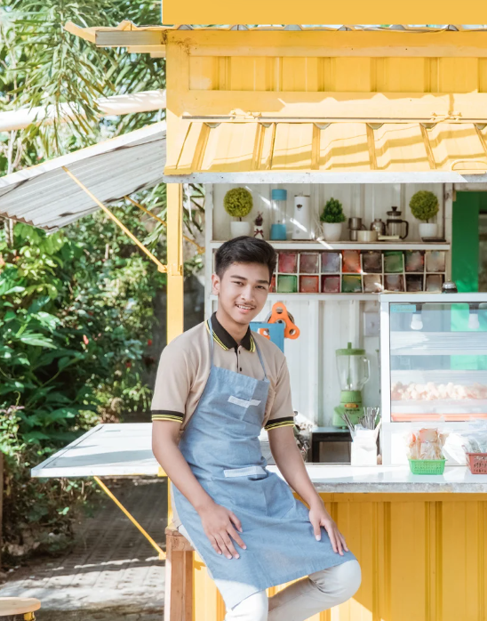
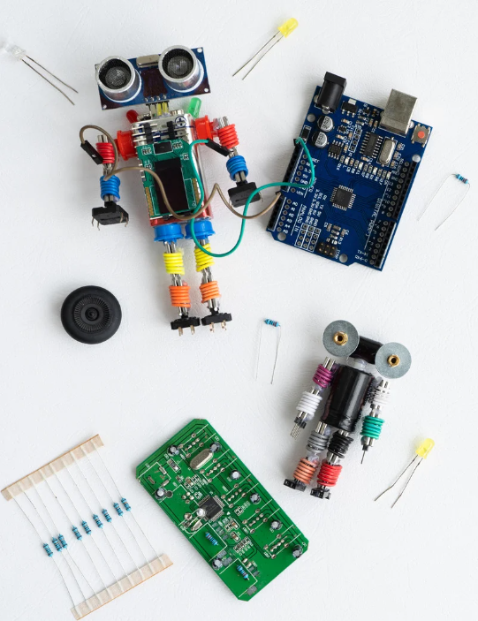
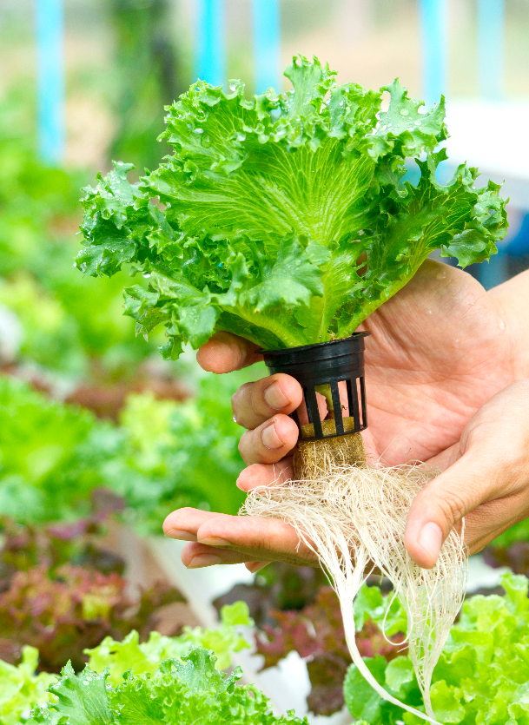
FUTURE SKILLS
Build Smart Farm Lab and upskill students with skills for the future.
ENTREPRENEURSHIP
STEM
GREEN SKILLS

Slide 2



